Slide 1
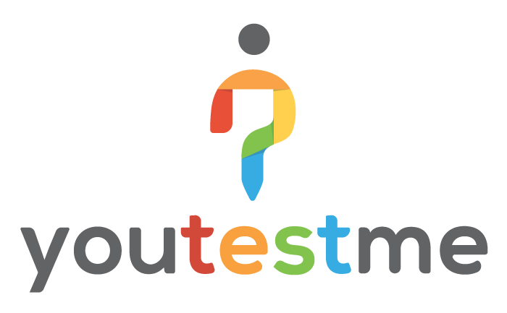
PITCH DECK

Slide 2
pre-configured virtual appliance that can be deployed on the cloud or local servers within 30 minutes.
Another advantage of our company is the pricing model, being a one-time fee, with no additional fees calculated per-user/test/survey.
ABOUT US
We are People with Vision
Our company has developed a web-based software family with a goal to eliminate manual, paper-based testing and reporting, thus saving thousands of working hours per year spent on these processes, as well as our clients’ money. We are streaming towards covering all evaluation processes (testing, surveying, training, soft skills). Unlike competing systems, our products are being delivered as a standalone,
Our products: DB Analyzer, Test Daemon, YouTestMe
Our clients: US government (FBI), Serbian government, (SMATSA), Hose & Rubber Supply, John Naisbitt University, Oracle Canada, Citibank, Scotia bank, Prudential, Nesbitt Burns, London Life, General Electric
Experience: Over 20 years

Slide 3
PRODUCTS
YouTestMe Products
YouTestMe represents a web-based software line of products specialized for knowledge evaluation and computer-based learning
Software for knowledge evaluation, surveys & certification
Learning Management System (LMS) & knowledge evaluation software
Classroom2020 adjusted to needs of colleges
Mobile application for taking quizzes generated using our Test Generator

Slide 4
LEADS & CLIENTS
Worldwide Map of Leads & Clients
On map below you can see that our clients and leads come from 6 continents

Slide 5
TARGET CUSTOMERS
Who are the Potential Customers?
Since customization is one of the benefits YouTestMe provides, it can be applied in many fields and industries
Corporate Sector
Government/Military/Public Sector
Education Sector
Certification for compliance
Professional certification
Employee training
Government employee training & certification
Certification or licensing of citizens
Frequent training
Student exams
Knowledge checks
Learning through testing

Slide 7
INCOME POTENTIAL
Income Potential is calculated by formula
INCOME = SOFTWARE SELLING PRICE + SOFTWARE CUSTOMIZATION + CUSTOMER TRAINING + ANNUAL MAINTENANCE FEE + X-SELLING – THIRD PARTY LICENSES – COST OF SOFTWARE DELIVERY – BUSINESS OPERATING COSTS – SALES COMMISSION

Slide 8
COMPETITIVE ADVANTAGES
Our Top 3 Competitive Advantages
1
Competition
YouTestMe has a very little or no competition at all relevant to software, technology and services.
2
Technology
YouTestMe is designed from ground up to be scalable, reliable and customizable. The best of the breed Enterprise technologies are used (Oracle database, Linux O/S, Java)
3
Operating Cost
Development and Support teams are located in Serbia which has excellent education system and source of new talents. Therefore, operation costs are one third of what would be in the North America.

Slide 9
DIFFERENCES OF YOUTESTME AND SIMILAR SYSTEMS
YouTestMe Stands out in 4 Key Things
1
Deployment Option
Deployment option is a solution where customer installs and controls YouTestMe software in their data centre. This is the best option for companies and institutions where control, data privacy and security is of highest concern.
2
Customization
Custom solutions can be developed around YouTestMe system. YouTestMe is suitable for quickly delivering knowledge testing and learning management system solutions for customers with specific requirements.
3
Integration with Other Systems
YouTestMe deployment solution can be integrated with existing systems, such as: authentication systems (single sign on), document management systems, e-commerce, etc.
4
Integrated Enterprise Technologies & Technical Solutions
YouTestMe system is developed integrating major enterprise technologies into highly scalable and configurable Virtual Servers. It can be used to deliver custom, highly scalable and reliable solution that can fulfil needs of large corporations, organizations and governments.

Slide 10
PARTNERSHIPS
YouTestMe & ProctorEdu Partnership
1
What is ProctorEdu?
ProctorEdu is a company that delivers an automated proctoring software solution. ProctorEdu minimizes the need for hiring people who will be proctors on exams.
2
The story of YouTestMe & ProctorEdu Partnership
In October 2017, YouTestMe and ProctorEdu started making an integration between ProctorEdu and YouTestMe GetCertified. The result is that now, YouTestMe can offer fully automated online exam and proctoring solution.
3
Benefits of Partnership with ProctorEdu
This kind of integration opens new doors and can target new market segments. For example, potential customers can be all companies that provide professional certifications that can be taken only on-site. With GetCertified and ProctorEdu, all certification exams could be done at home.

